Slide 1
Relational data

Slide 2
Three families of verbs for relational data
Mutating joins, which add new variables to one data frame from matching observations in another.
Filtering joins, which filter observations from one data frame based on whether or not they match an observation in the other table.
Set operations, which treat observations as if they were set elements.

Slide 3
Keys
A variable (or set of variables) that uniquely identifies an observation
A primary key uniquely identifies an observation in its own table [can be a set of variables]. For example, planes$tailnum is a primary key because it uniquely identifies each plane in the planes table.
A foreign key uniquely identifies an observation in another table [can be a set of variables]. For example, the flights$tailnum is a foreign key because it appears in the flights table where it matches each flight to a unique plane.

Slide 4
Relations
Typically one-to-many
Each flight has one plane, but each plane has many flights
Can also be many-to-many
Each airline flies to many airports; each airport hosts many airlines
Can also be one-to-one

Slide 5
Understanding joins

Slide 6
Understanding joins
Each potential match

Slide 7
Understanding joins
Each potential match
Number of actual matches
Inner join: Unmatched rows are not included in the output

Slide 8
Outer joins
Keeps all observations in x
Keeps all observations in y
Keeps all observations in x and y

Slide 9
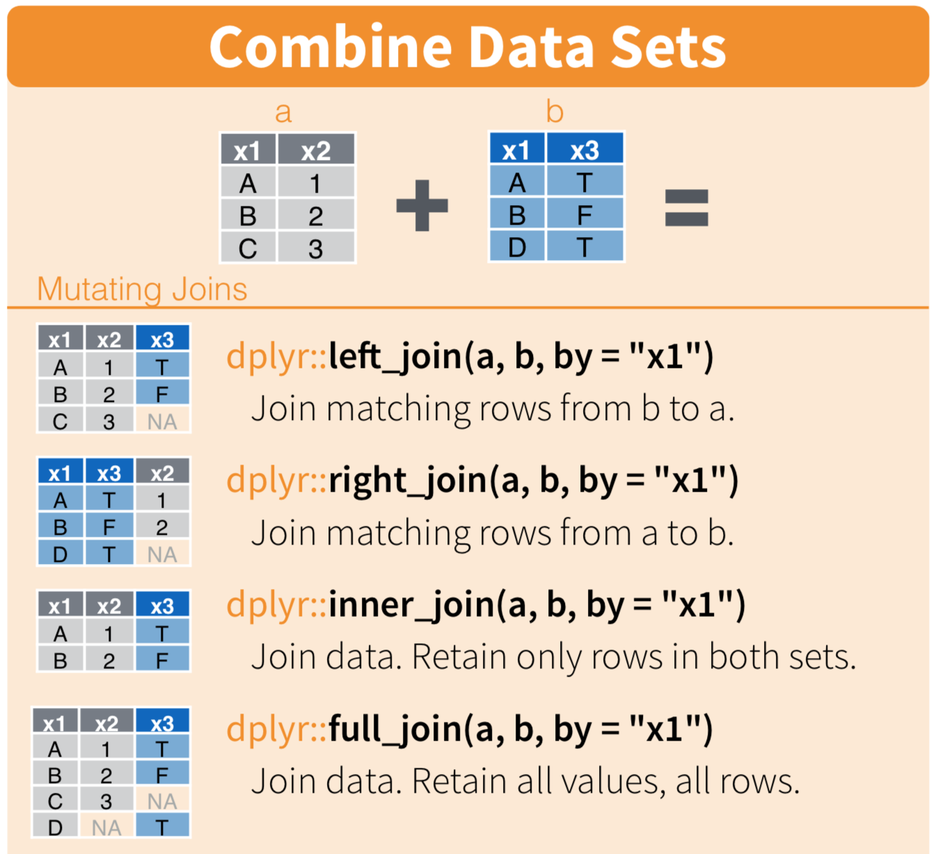

Slide 10
Duplicate keys
One table has duplicate keys (typically a one-to-many relationship) e.g. “dest” in the flights tibble

Slide 11
Duplicate keys
Both tables have duplicate keys (typically an error)

Slide 12
Filtering
semi_join(x, y) keeps all observations in x that have a match in y.
anti_join(x, y) drops all observations in x that have a match in y.

Slide 13
Semi-join
Anti-join

Slide 14
Exercises
Filter flights to only show flights with planes that have flown at least 100 flights
Combine fueleconomy::vehicles and fueleconomy::common to find only the records for the most common models

Slide 15
Join problems – how to troubleshoot
Start by identifying the variables that form the primary key in each table based on your understanding of the data
Check that none of the variables in the primary key are missing. If a value is missing then it can’t identify an observation!
Check that your foreign keys match primary keys in another table. The best way to do this is with an anti_join()

Slide 18
Tibbles
“Opinionated data.frames”
Never changes the type of the inputs (e.g. it never converts strings to factors!)
Never changes the names of variables
Never creates row names
Never partial matching to variable names

Slide 19
Printing
tibbles vs. data.frames

Slide 20
Subsetting
With tibbles: primarily with dplyr::filter() and dplyr::select()
‘[’ always returns a tibble
In data.frames: primarily with ‘[’
‘[’ an either return a data.frame or a vector

Slide 21
Data classes in R

Slide 22
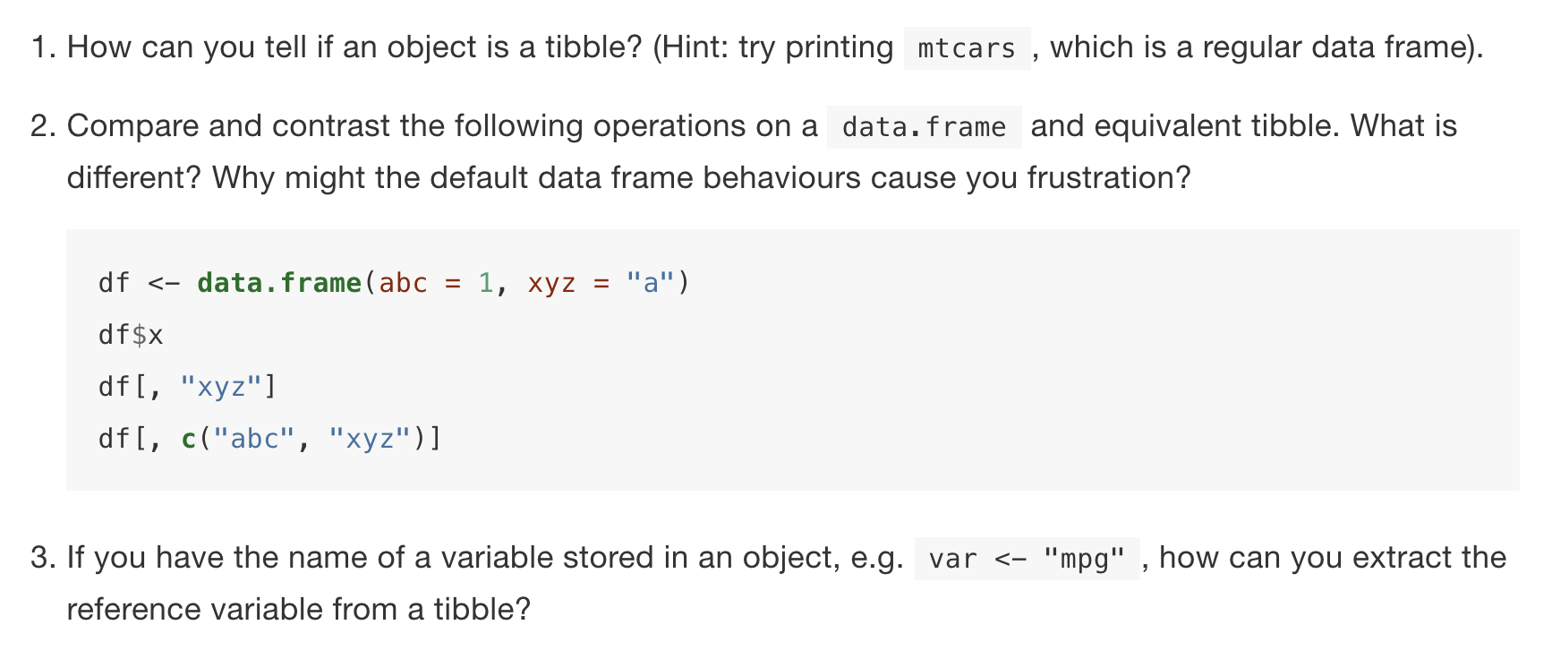
Exercises

Slide 23
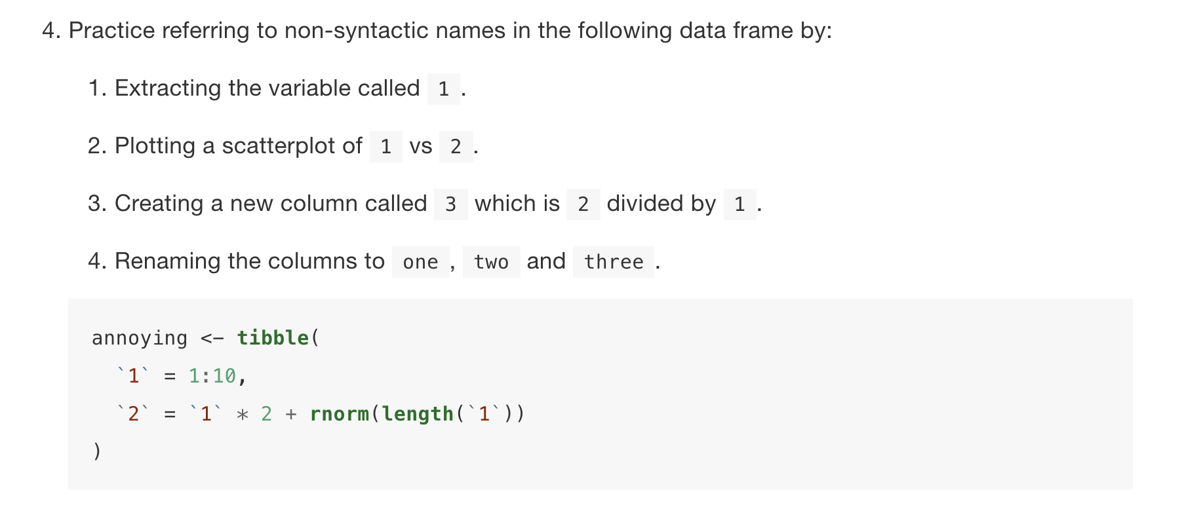

Slide 25
Exercises
Explore the distribution of rincome (reported income). What makes the default bar chart hard to understand? How could you improve the plot?
What is the most common relig in this survey? What’s the most common partyid?

Slide 26
Now create a similar plot looking at how average age varies across reported income level

Slide 27
Exercises
Add the location of the origin and destination (i.e. the lat and lon) to flights.
IF MORE TIME:
Is there a relationship between the age of a plane and its delays?

